Slide 1


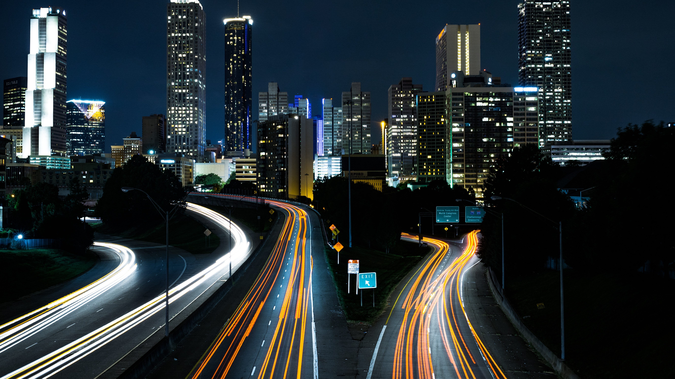
Driver Drowsiness Detection
By-
Onasvee Banarse
Kaustubh Kabra
Himanshu Bendale
Vincent Simon
Harsh Shah
Project Guide :
S1 : Dr. S. N. Zaware
S2 : Mrs. S.R. Agrawal
S3 : Dr. K.S. Wagh
S4 : Ms. A.S. Varal

Slide 2
What is Driver Drowsiness?
Feeling abnormally sleepy or tired during the day is commonly known as drowsiness. Drowsiness may lead to additional symptoms, such as forgetfulness or falling asleep at inappropriate times.
Drowsiness makes a person sleepy during inappropriate situations or inappropriate time.
Drowsiness of a driver is extremely dangerous as he loses the control of the vehicle which risks many lives.
It is the root cause of majority of the road accidents.

Slide 3
Causes of Driver Drowsiness
Sleep deprivation: Lack of sleep is a leading cause of excessive daytime sleepiness, which can induce micro sleeps or other dangerous driving behavior. Adults should get between seven and nine hours of sleep each night, but a significant number of adults routinely fail to get this recommended amount of sleep.
Alcohol: Drinking alcohol can prompt sleepiness while also affecting reaction time and decision-making in ways that increase the risks of auto accidents.
Time of day: Auto accidents from drowsy driving occur most frequently between midnight and six a.m. or in the mid-afternoon, which are two times when sleepiness peaks.

Slide 4
Impact of Driver Drowsiness
Every year the amounts of deaths and injuries are increasing in traffic accidents due to human errors.
If the Driver failing to concentration on driving it reduces the driver reaction time and impair steering behavior.
We often hear of drunken driving, no seat belt, speeding, road condition, bad weather and mechanical failures. But one of the biggest and yet often unrecognized human errors is drowsy driving. A major problem not only in India but across the globe. The risk, danger, and often tragic results of drowsy driving are alarming indeed. Obviously lack of sleep is the main culprit.
Falling asleep at the wheel is suicidal. It is not only dangerous to the driver but to all other road users. It certainly jeopardizes the safety.
Exhausted drivers who doze off at the wheel are responsible for about 40% of road accidents, says a study by the Central Road Research Institute (CRRI) on the 300-km Agra-Lucknow Expressway. The finding rings the alarm bell on how Indian highway motorists ignore the importance of taking adequate rest and end up endangering lives.

Slide 5
Signs for a rest
Some signs which indicate that you should rest or take a break while driving are
Drooping eyelids
Yawning repeatedly or rubbing eyes
Blurry vision
Nodding head
Drifting from lane
Not able to concentrate
Instead of taking a chance, the person driving the vehicle should pull off, wash his/her face or take a nap in the vehicle if possible.

Slide 6
Environment used
Our project will be implemented with python as a programming language.
Some of the packages used are-
OpenCV
dlib
Numpy
Keras
Imulits
Scipy
Math
OS

Slide 7
ADVANTAGES OF THE SYSTEM
Security of vehicle and Driver.
Reliable and very fast.
Up to 90% Accuracy(Accuracy can be increased using different models and Vehicle based Methods).
Non-Intrusive and Ease of Use.
Cost Efficiency is more than other systems.
DISADVANTAGES OF THE SYSTEM
Miss detects the eye corners as the eye centers.
Light Conditions and Background may affect the Detection of Drowsiness.

Slide 8
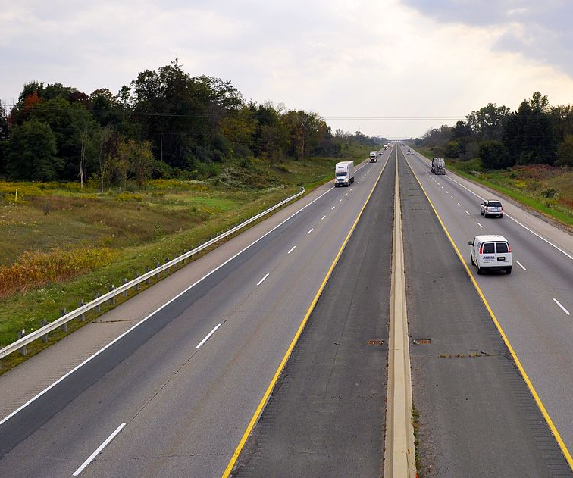
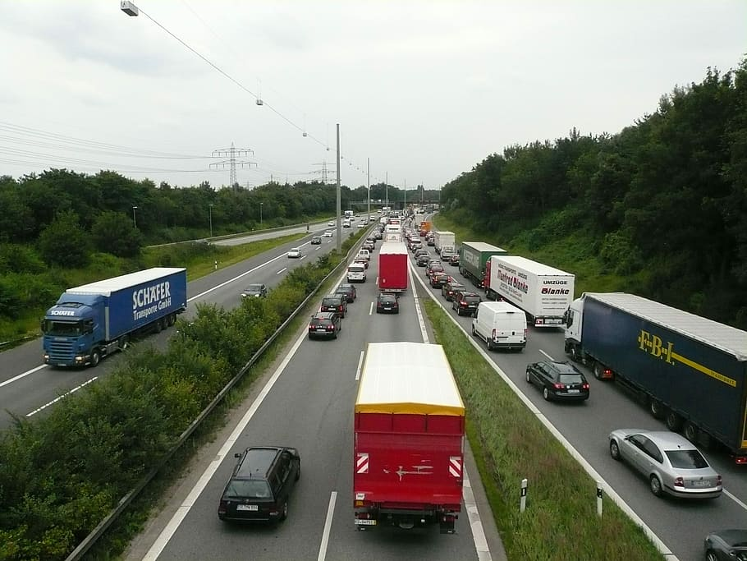
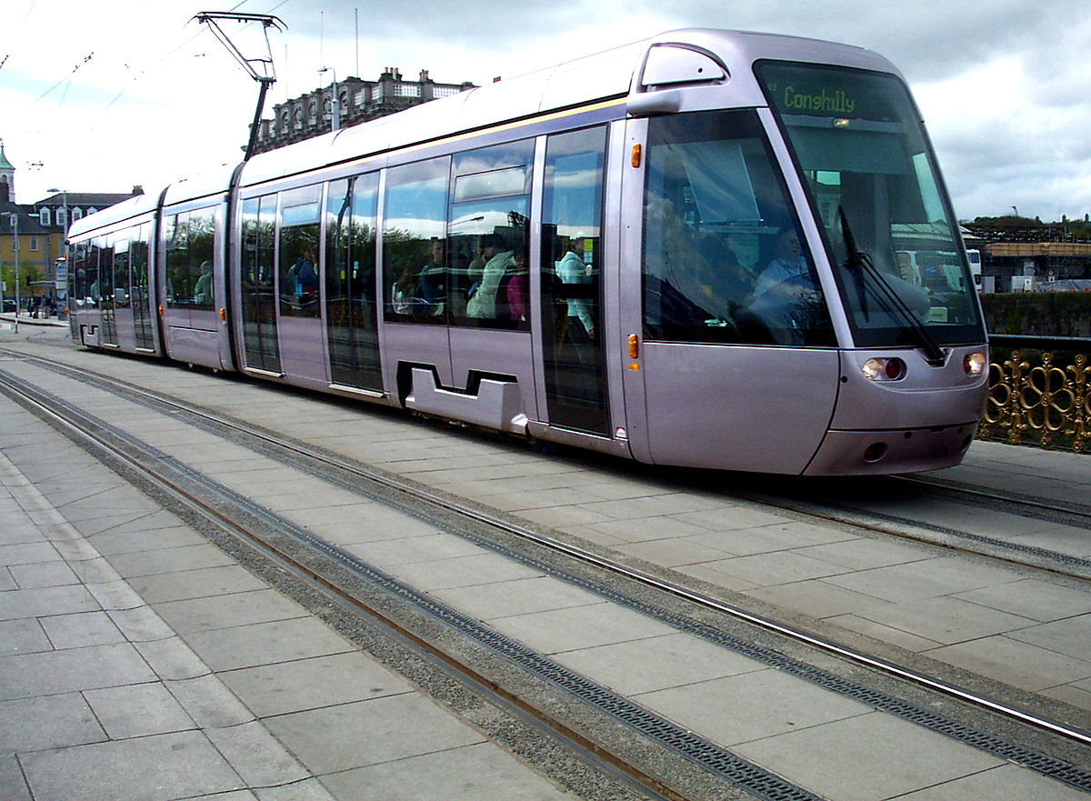
APPLICATIONS
Best use of this system is in Trucks and Bus as they have a long journey to travel.
Further we can use these systems in different modes of transport.

Slide 9

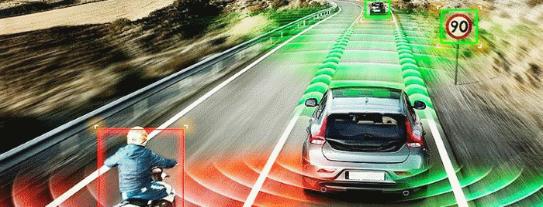
Future Enhancement
Vehicle Based Detection Features
In case of an accident , share location of vehicle to ambulance, police, fire brigade and 5 close peoples of the driver.
Earlier detection using Physiological Method.

Slide 10
Thank you

